Slide 1

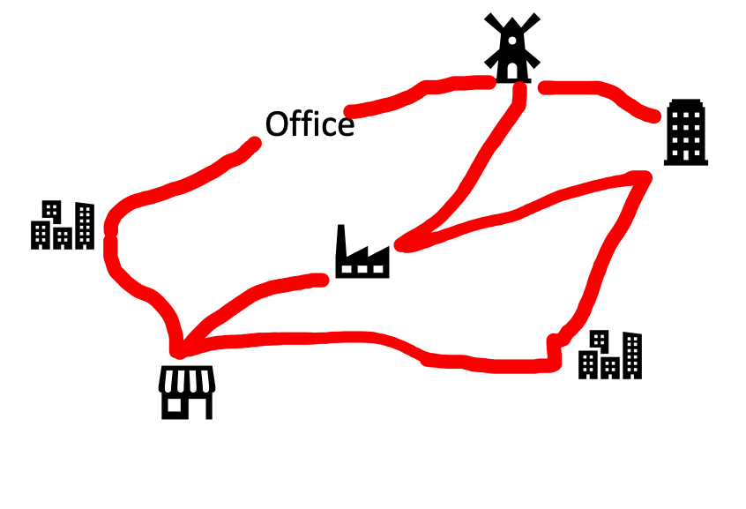
Traveling Salesman Problem (TSP)
Consider the following situation. You are given a list of n cities with the distance between any two cities. Now, you have to start with your office and to visit all the cities only once each and return to your office. What is the shortest path can you take? This problem is called the Traveling Salesman Problem (TSP).
Alka Singh AI Unit 02

Slide 2
Problem Formulation of TSP
To make the problem simple, we consider 3-city-problem.
Let’s call the office ( A )and the 3 cities ( B ) ( C ) ( D ) respectively. We initialize the problem state by {A} means the salesman departed from his office. As an operator, when he visited city-B, the problem state is updated to {A, B}, where the order of elements in { } is considered. When the salesman visited all the cities, {A, B, C, D} in this case, the departed point A is automatically added to the state which means {A, B, C, D, A}. Therefore, the initial state of this TSP is {A} and the final state(goal) is {A, X1, X2, X3, A} where traveled distance is minimized.
Taking each state as a node of a tree structure, we can represent this TSP as the following tree search problem.
Alka Singh AI Unit 03

Slide 3
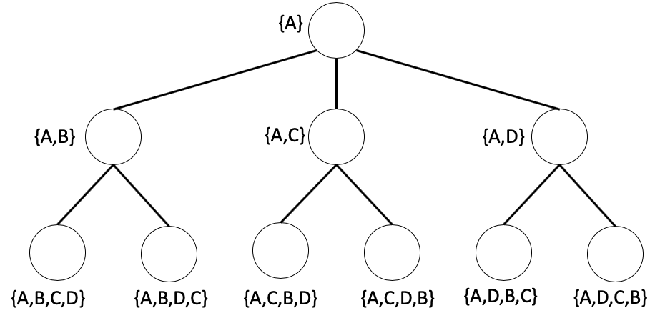
Alka Singh AI Unit 03

Slide 4
Brute-force search
Depth-first search
The depth-first search algorithm starts at the root node and explores as deep as possible along each branch before taking backtracking. In our TSP, when a state node with all city labels is visited, its total distance is memorized. This information will later be used to define the shortest path.
Let VISIT be a stack to save visited nodes, PATH be a set to save distances from the root node to the goal. The depth-first algorithm can be written as
Alka Singh AI Unit 03

Slide 5
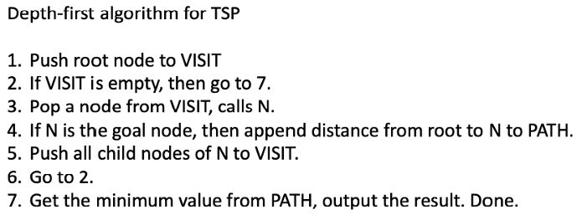
Alka Singh AI Unit 03

Slide 6
Breadth-first search
The depth-first search algorithm starts at the root node and explores all of the nodes at the present depth level before moving on to the nodes at the next depth level. In our TSP, when a state node with all city labels is visited, its total distance is memorized. This information will later be used to define the shortest path.
Let VISIT be a queue to save visited nodes, PATH be a set to save distances from the root node to the goal. The breadth-first algorithm can be written as
Alka Singh AI Unit 03

Slide 7
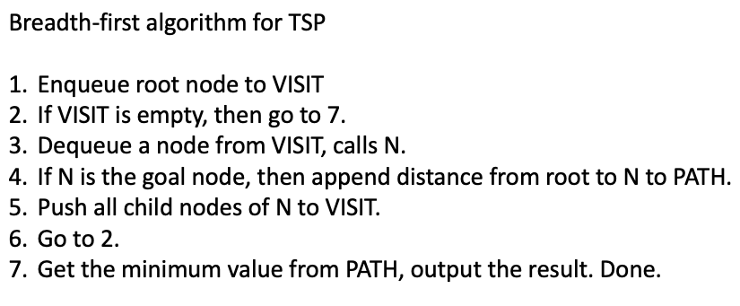
Alka Singh AI Unit 03

Slide 8
Heuristic Search
In Brute-force search, all nodes are visited and the information from each node (distance from a node to a node) is not considered. This leads to a large amount of time and memory consumption. To solve this problem, a heuristic search is a solution. The information of each state node is used to consider visiting a node or not. This information is represented by a heuristic function which commonly set up by user’s experiences. For example, we can define the heuristic function by the distance from the root node to the present visit node, or the distance from the present visit node to the goal node.
Alka Singh AI Unit 03

Slide 9
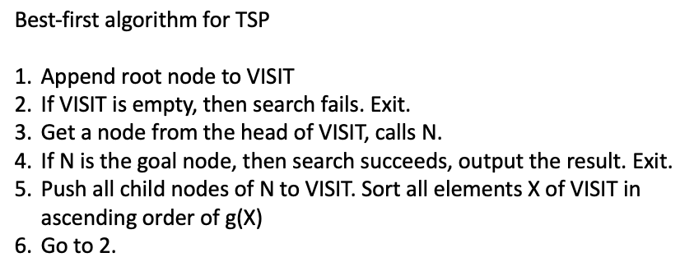
Best-first search
In the Best-first search, we use the information of distance from the root node to decide which node to visit first. Let g(X) be the distance from the root node to node-X. Therefore, the distance from the root node to node-Y by visiting node-X is g(Y)=g(X)+d(X, Y), where d(X, Y) is the distance between X and Y.
Let VISIT be a list to save visited nodes. The best-first algorithm can be written as
Alka Singh AI Unit 03

Slide 10
(A*-algorithm)
In the A* algorithm search, we use the information of distance from the present visit node to the goal as a heuristic function, h(X). Let g(X) be the distance from the root node to node-X. In this case, we consider the priority of node visit order by f(X)=g(X)+h(X).
In real-world problems, it is impossible to obtain the exact value of h(X). In that case, an estimation value of h(X), h’(X), is used. However, setting h’(X) takes risks in falling into a local optimal answer. To prevent this problem, choosing h’(X) which h’(X)≤h(X) for all X is recommended. In this case, it is known as A*-algorithm and it can be shown that the obtained answer is the global optimal answer.
Alka Singh AI Unit 03

Slide 11
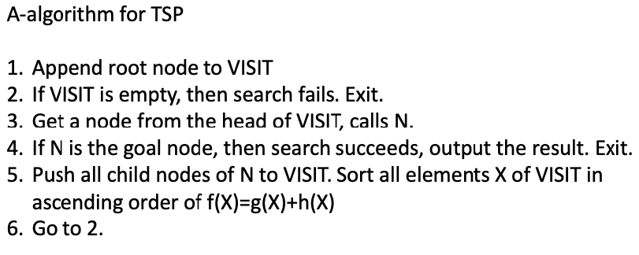
Alka Singh AI Unit 03

Slide 12

Alka Singh AI Unit 03

